Slide 1

Capstone Project
Play Store App Review Analysis
By
Adil Imam
Asadullakhan Pathan
Md Sazil Sharif
sushil kumar singh
Madhulika Kumari
Data Science Trainee, AlmaBetter

Slide 2






WHY ANALYZE THE GOOGLE PLAY STORE?
Mobile App Market is set to grow 20% by 2023
Android Apps comprise 90% of the Mobile App Market
What makes an App popular? Can we predict how popular it’s going to be?
What are some interesting patterns in user behavior related to app usage & feedback?

Slide 3
Introduction
Android is the most popular operating system in the world, with over 2.5 billion active users spanning over 190 countries.
Google Play was launched on March 6, 2012, bringing together Android Market marking a shift in Google's digital distribution strategy .
Android is the dominant mobile operating system today more than 85% of all mobile devices running Google’s OS. The Google Play Store is the largest and most popular Android app store.
There are more than 3.04 million apps found on Google Play Store.
The Play Store apps data has enormous potential to drive app-making businesses to success.
Actionable insights can be drawn for developers to work on and capture the Android market. The main goal of our project is-
The purpose of our project is to gather and analyze detailed information on apps in the Google Play Store in order to provide insights on app features and the current state of the Android app market.
The Objective of the project to Explore and analyze the data to discover key factors responsible for app engagement and success.

Slide 4


Problem Statement
Problem Statement
Two datasets are provided, one with basic information and the other with user reviews for the respective app.
We must examine and evaluate the data in both datasets in order to identify the important characteristics that inﬂuence app engagement and success.
So, what factors inﬂuence an app's success?
An app is said to be successful if it has:
A high average user rating
A good number of positive reviews
A good number of monthly average users
High revenue per customer and so on.

Slide 5
Problem Statement
Which are Top categories on Google Play store?
Which category of Content is found more?
Distribution of the ratings of the apps?
What percentage of apps are Free and Paid?
Which category of apps has the greatest number of installs?
What are the Top 10 installed apps in different categories?
Which are the top expensive Apps?
Which are the Apps with the highest number of reviews?
Count of Apps found in different genres?
Which are the apps that have made the highest-earning?

Slide 6

Dataset Preparation
Loading the data sets: Two datasets, First Play store app
dataset and User Reviews dataset.
Import Libraries: NumPy, Pandas, Seaborn and Matplotlib
Data cleaning: Null values, Finding and removing Outliers, Removing duplicate data.
Data Imputation: Filling the missing categorical values with mode and numerical values with median. Conversion of price, installs, reviews into numerical values.
Exploratory Data Analysis: Analyzing the data sets to summarize their main characteristics using statistical graphics and data visualizations method.

Slide 7
1.App : This column Contains the name of the app for each observation. 2.Category : This column Contains Category to which the app belongs. 3.Rating : This column contains the average rating for the app. 4.Reviews : This column contains the number of reviews that the app has received on the play store. 5.Size : This column contains the amount of memory the app occupies on the device. 6.Installs : This column contains the number of times that the app has been downloaded and installed from the play store. 7.Type : This column contains the information whether the app is free or paid. 8.Price: If the app is a paid app, this column contains the data about its price. 9.Content Rating: This column contains the maturity rating of the app i.e. the age group of the audience for which it is suitable. 10.Genres: This column contains the data about to which genre the app belongs. Genres can be considered as a further division of the group of Category. 11.Last Updated: Contains the date on which the latest update of the app was released. 12.Current Version: Contains information on the current version of the app available on the play store. 13.Android Version: Contains information about the android versions on which the app is supported.
Attributes in Google Play store Data

Slide 8

Attributes in User reviews
App- Application name
Translated Review- User review
Sentiment- Positive/Negative/Neutral
Sentiment Polarity- Sentiment polarity score
Sentiment Subjectivity- Sentiment subjectivity score

Slide 9



OVERVIEW OF ANALYSIS
Data Cleaning
Data Exploration
Predictive Modeling
Understand the structure of the dataset and clean data before analysis
Uncover initial patterns, characteristics, and points of interest using visual exploration
Formulate a statistical model to forecast an outcome using relevant predictors

Slide 10
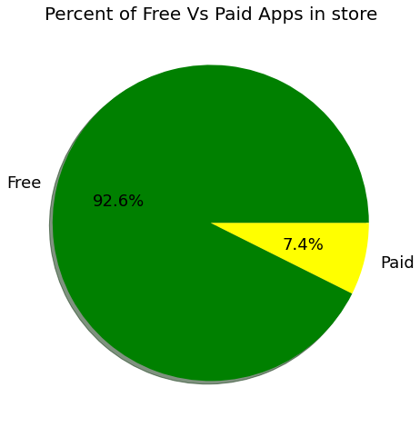
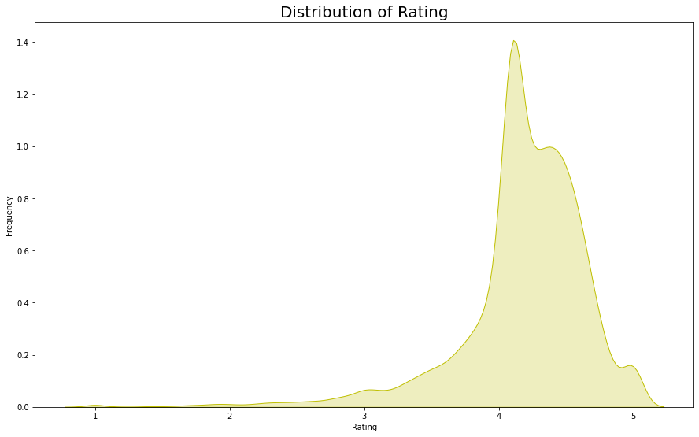
Percentage of Paid apps v/s Free apps
We Observed that 92.20% of Apps are free and only 7.80% of Apps are paid in Play store.

Slide 11
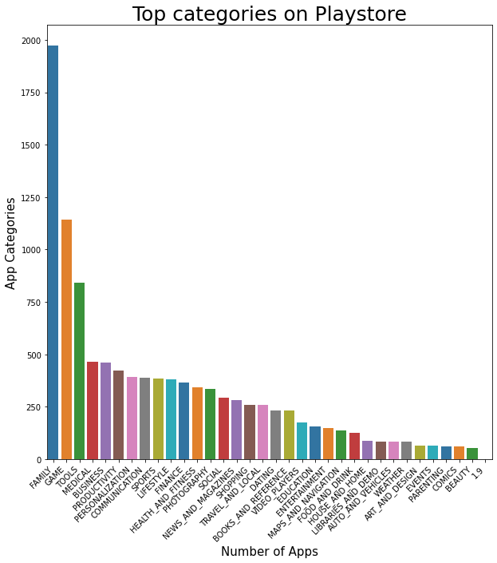

Slide 12
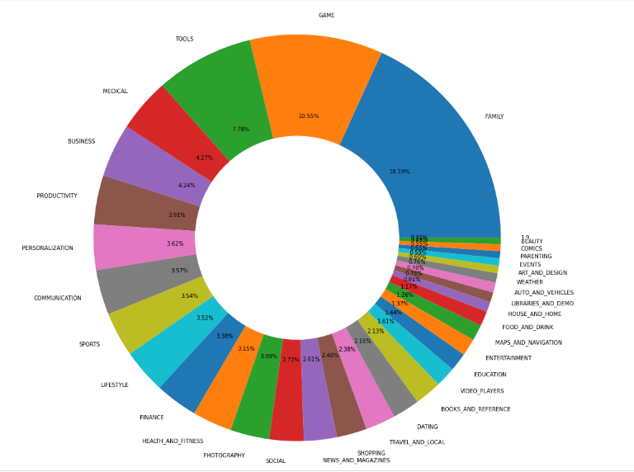
Percentage of apps belonging to each category in the playstore

Slide 13
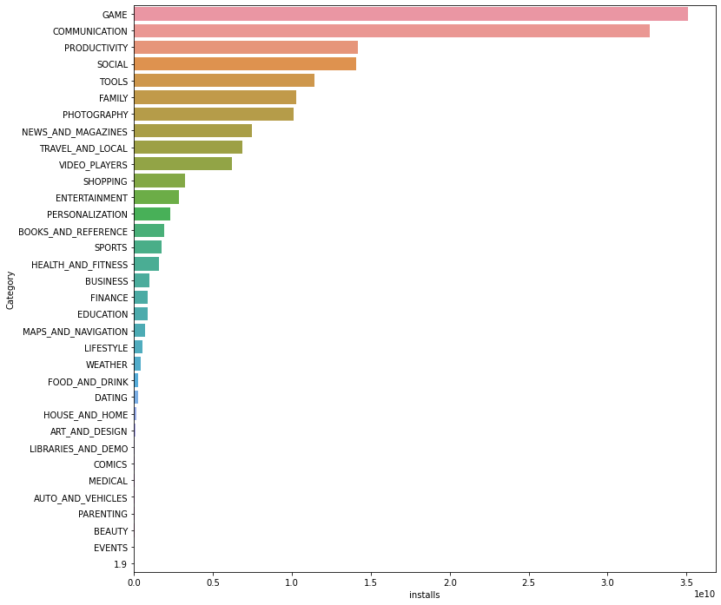
category Apps which are having most number of installs

Slide 14
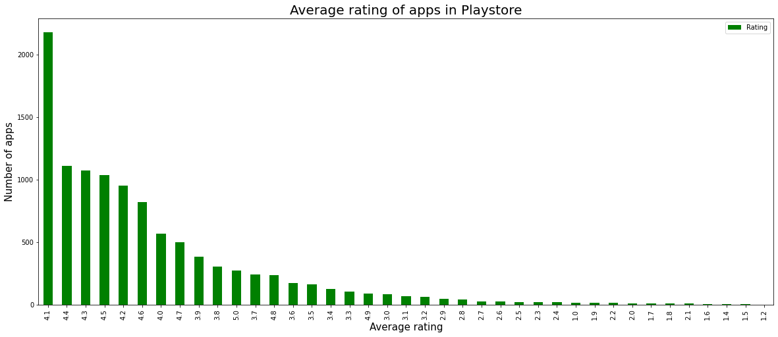

Slide 15
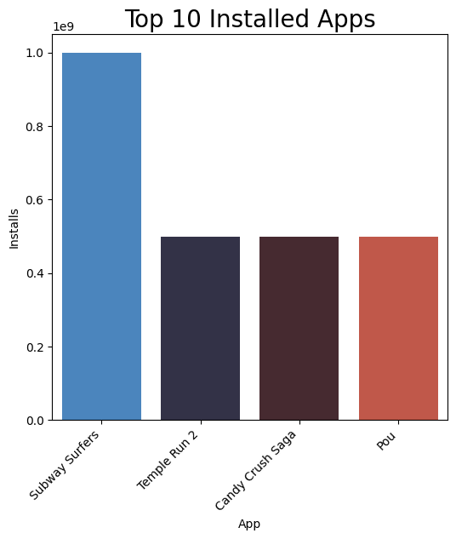

Slide 16
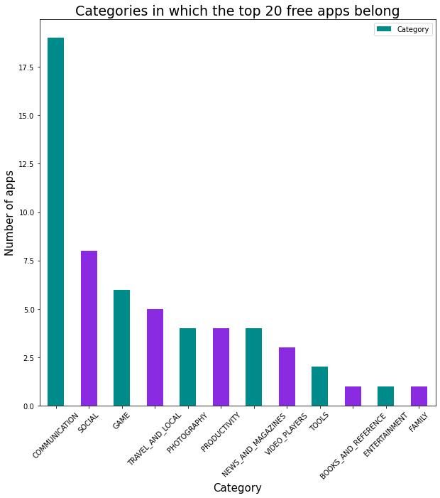

Slide 17
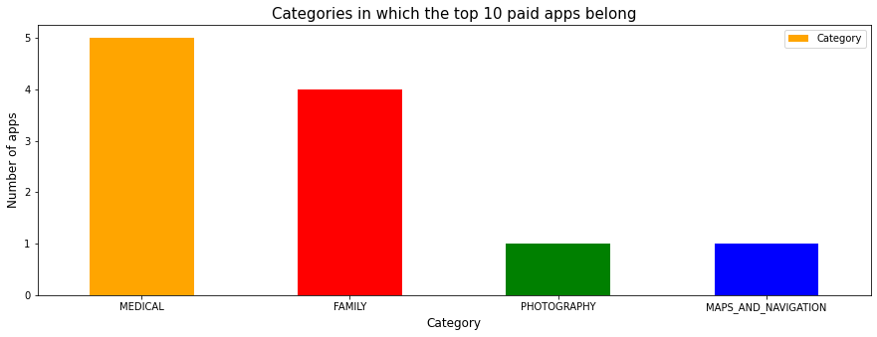
Category in which the top 10 paid app belong

Slide 18
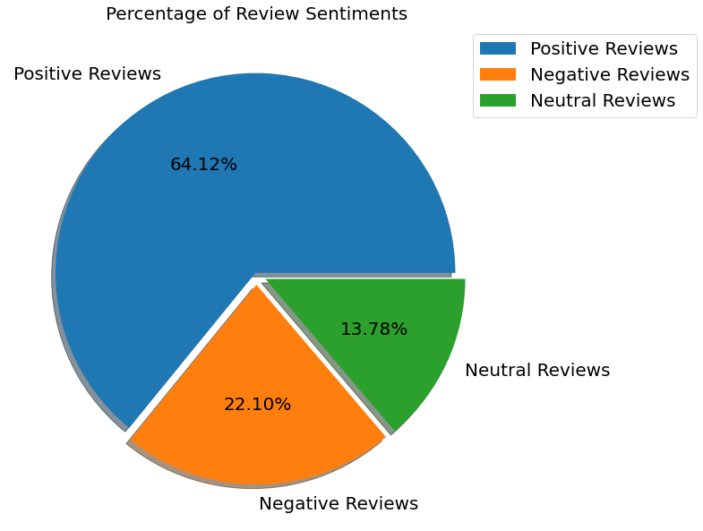
The number of Unique Apps from Play store and User reviews merged dataset are 816.
From Sentiment column, 64% are Positive, 22% are Negative and 14% are Neutral values.

Slide 19
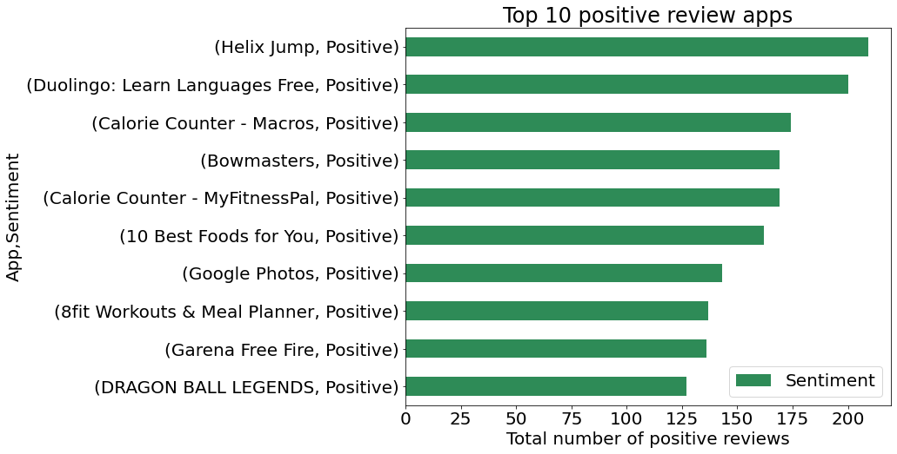

Slide 20
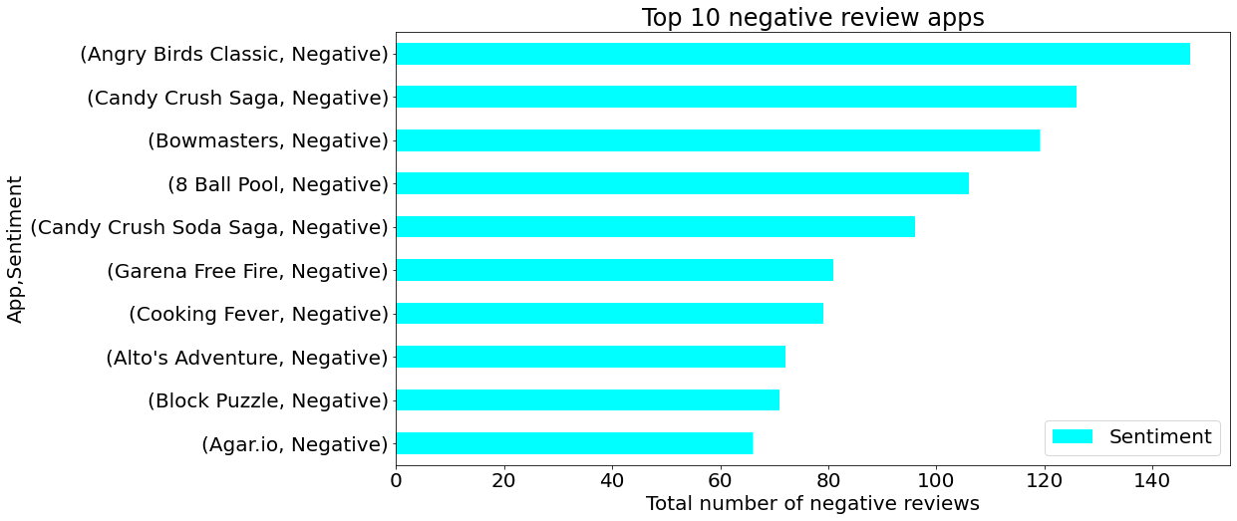

Slide 21
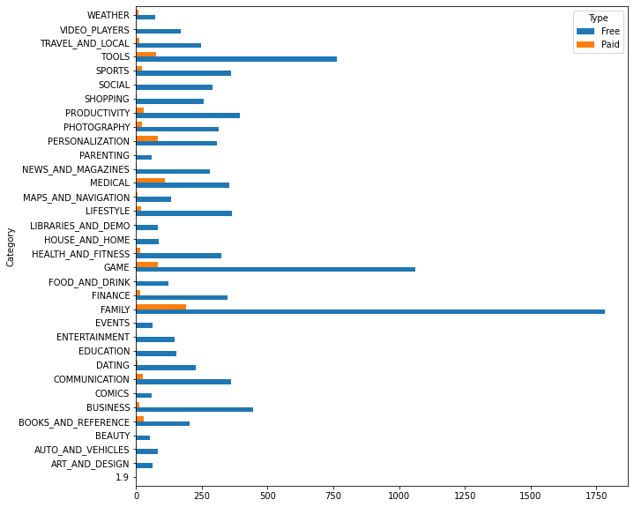
App which contains are Free vs paid blue line indicates free and orange line indicates paid

Slide 22
Challenges Faced
Reading the dataset and comprehending the problem statement.
Examining the business KPIs for app development and devising a solution to the problem.
Handling the error, duplicate and NaN values in the dataset.
Designing multiple visualizations to summarize the information in the dataset and successfully communicate the results and trends to the reader.

Slide 23
Conclusion’s
92.19% apps are Free and 7.81% apps are paid in type.
81.80% apps have Everyone content rating.
Events category has a highest mean rating of 4.39 and Dating category has lowest 4.05 rating.
Family, Game and Tools are top three categories having 1906, 926 and 829 app count.
Most competitive category: Family
Category with the highest number of installs: Game
Tools, Entertainment, Education, Business and Medical are top Genres.
8783 Apps are having size less than or equal to 50 MB.
7749 Apps has rating more than 4.0 including both type of app.
Overall sentiment count of merged dataset in which Positive sentiment count is 64%, Negative 22% and Neutral 14%.

Slide 24


